Slide 1
Application of the Viscoelasticity of the Brain Tissues to Describe Waking-Sleep Continuity Theory Mostafa M. Dini

Slide 2
Brain Activities & Their Connections
In this Presentation
Physical activities of the brain tissues in neural network scales
Relation between layers of activity (physical and psychological)
Different states of mind and continuity in activities in the states.

Slide 3
Part One
Definition of Stress
Stress Load & its Regulation
Stress effect in cellular Structure and Memory
Straining in Normal Range
Stress Field
Interaction Between Macro & Micro Scales
Angular Strains & Strain Residue
Difference Between Normal Elastic & Viscoelastic Tissues
Linear & Non-Linear Viscoelastics

Slide 4
Definition of Stress
Stress is a pressure that disturbs brain balance
Brain regulates strain over its tissues;
If stress beyond normal regulatory limit, considered psychological stress; “condition where an environmental demand exceeds the natural regulatory capacity of [brain]”- Koolhaas, J., et al; 2011
Stress within regulatory limit is normal stress

Slide 5
Stress Load and its Regulation
Stress Load
Tissue or Neural Network under frequency different from its resting frequency
Regulation
Along stress distribution pathways, self-regulatory controls “straining” by “relaxing”
Strain fluctuations homeostaticly regulated within tissues safe range (Kinematics)

Slide 6
Straining ranges in normal range
The daily tissues straining is very small and with no significant short-term effect
Removing the stress source, the tissue returns almost to the original position
the ventricles, cavities; which strain measures is in it, because
of cerebral fluid diffusion
(Lynne E. Bilston, 2011)

Slide 7
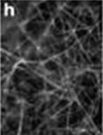
Stress Field
Distributes as stress field
Equivalent stress – Vector (for simplicity)

Slide 8
Interaction Between Macro and Micro
Effect of straining cause to synchronize firing
Stress-strain fluctuations change connections strength in neural networks & vary neural networks substrates (memory sites)
100 nm size of cell's membrane changes
in ion transfers
(Jinkee Lee1, et al ; 2012)

Slide 9
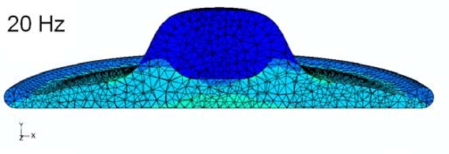
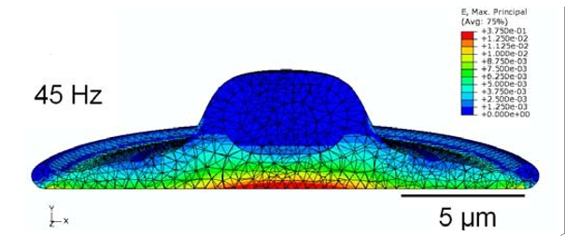
Angular Strain & Strain Residue
Strains work in different directions internally nullify each other in large scales in normal range stress fields
Angular strains may remain significant, supporting strain “residues”
(Jaques S. Milner; et al; 2012)

Slide 10
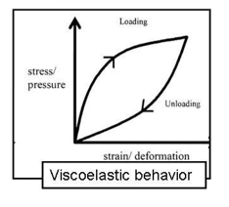
Difference between Normal Elastic & Viscoelastic Tissue
Viscoelastic materials exposed to stress force, react by 2 different viscous & elastic forces
Viscous forces stored in the material & release time-dependently
Equivalent energy for viscous forces measured from area between loading & unloading curves – is potential strain “residue” remaining in material

Slide 11
Linear & Nonlinear Viscoelastics
Brain tissues interconnected – time-lag in stress field inductions & relaxations influence response of integrated tissues /areas
Behavior of brain as integrated tissues network, complex nonlinear viscoelastic (Giulia Franceschini; 2006)

Slide 12
Part 2
Relating Tissues Physical Activities to Mind Activities
Expansion of Brian Activities

Slide 13
Relating Tissues Physical Activities to Mind Activities
Stress-straining regulates synchrony of firings in network under loading/ unloading
Synchrony of firings intensify energy intensity over network:
Stress field tenses to deform networks from origin configuration; relaxing brings it back to origin configuration
Network hosting memory component activated

Slide 14
Expansion of Brain Activity in Recalls & Creations
Stress field expansion in circuits that link memory features spatially / temporally create brain activity:
Features joined exactly as the experience of subject or event is a recall
Different features from different experiences link spatially / temporally support creative activity

Slide 15
Part 3
Expansion of Brain Activity in Recalls & Creations
Change from Waking to Sleep State
Continuity Between Different States of Mind
Conclusion

Slide 16
Change from Waking to Sleeping State
Equivalent Functional & Relaxing curves for active circuit during waking have different “stress-strain correlation” in waking & sleep
Curves connected
Followed afterwards or delay
Nullified or intensified
Waking circuit – features in frontal lobe (conscious)
Relaxing circuit lacks those features (subconscious)

Slide 17
Change from Waking to Sleeping State (cont.)
Accumulating “residue” energy physical equivalent for emotion product
Residue strains release whenever input stresses removed
Elasticity degrades with accumulation of “residue” strains
Sleep a necessity for proper brain functioning

Slide 18
Change from Waking to Sleeping State (cont.)
Brain activities in waking = 50000 thought fragments (15000-70000)
Number of passive thoughts, 100 times less in sleep, because of shared networks
Strains “Residues” expand physically in passive dreams – “as-it-is” / passive automatic thoughts

Slide 19
Continuity Between Different States of Mind
Accumulated “residue” energy between Functioning & Relaxing curves transfers from waking to sleep
Ideally energy consumed in sleep to relax brain
Rarely happens
A base level of strains related to working memory of sleep activities
Some remains of “residues” to next day

Slide 20
Conclusion
Waking-Sleep continuity detailed based on energy residues left in viscoelastic brain tissues
Continuous “discrete stress-straining” in neural networks may leave “residues”; “residues” build up during waking
“residues” relieve & initiate steps of “discrete strain-stress” of dreaming in sleep

Slide 21
Conclusion
Each stage of sleep may cover “residue” relief (relaxation) caused by few to several waking “residues”. Thus, continuity has a gradation.
Circuits repeated for same daily issues may initiate dreams related to longer span of time
Not only waking “residues” pop up in dreams; dream “residues” transfer to waking thoughts. These “residues” for healthy life are much smaller

Slide 22
Thank you

